Slide 1
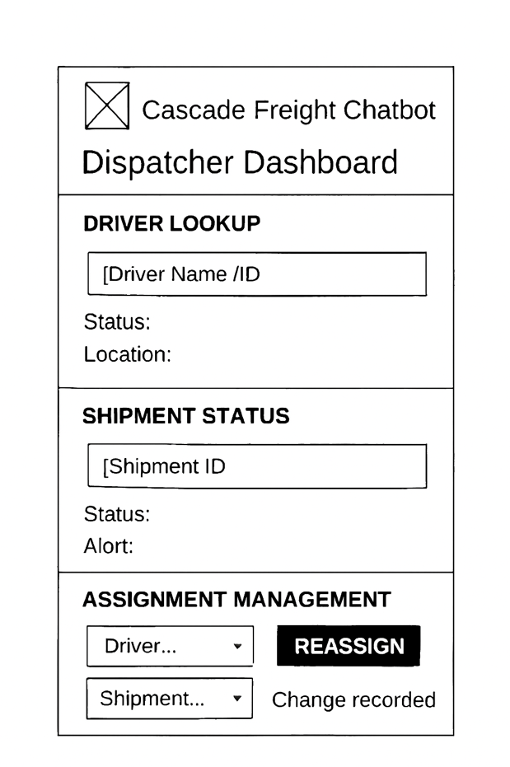
Cascade Freight Systems Chatbot
User Account Administration
User Story – 2.0 Dispatcher Dashboard Page
As a dispatcher, I want a centralized dashboard that shows all active shipments, driver assignments, and delivery statuses in real time so that I can efficiently coordinate freight movement, quickly resolve issues, and ensure on‑time deliveries.
Development Tasks
UI: Build dashboard layout with shipment list, driver list, map view, filters, and alerts.
Backend: Create APIs for shipments, drivers, assignments, and real‑time updates.
Integration: Connect to GPS/location services, enforce role‑based access, log assignment changes.
Reports: Generate daily summary export (CSV/PDF).
Testing: Unit/UI tests, performance checks, and security validation.

Slide 2
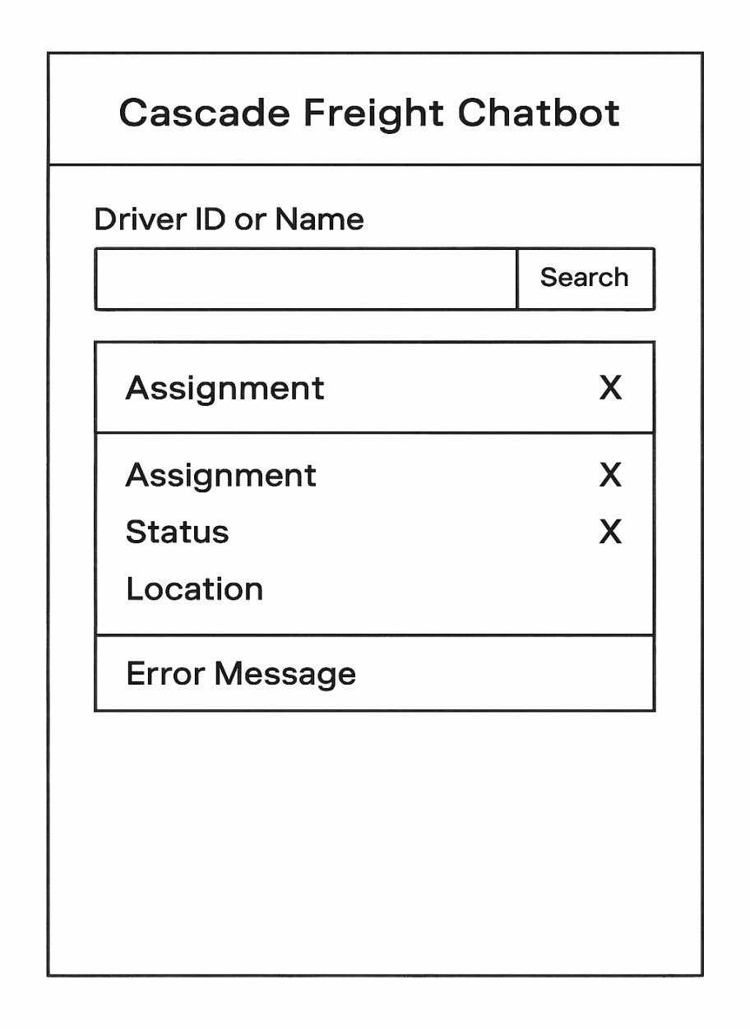
Cascade Freight Systems Chatbot
User Account Administration
User Story – 2.1 Driver Lookup
As a dispatcher, I want to query a driver’s current assignment and location so that I can quickly determine their availability and status for new or ongoing shipments..
Development Tasks
Database: Set up driver assignment and status tables; connect to GPS/logs.
Backend: Build API for driver lookup; return assignment, status, and location; handle errors.
Frontend: Create input for driver ID/name; display results clearly; show error messages.
Security: Enforce role‑based access; log queries for audit.
Testing: Run unit, integration, and user acceptance tests.

Slide 3
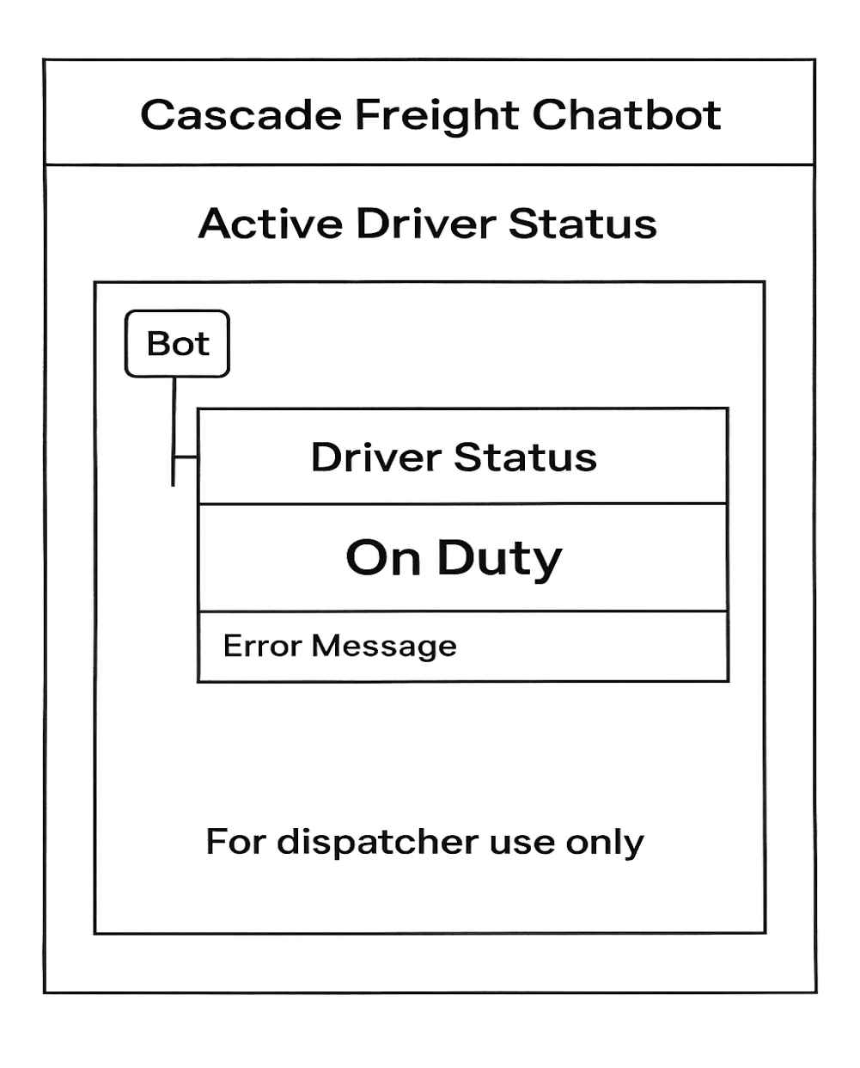
Cascade Freight Systems Chatbot
User Account Administration
User Story – 2.1.1 Active Driver Status
As a dispatcher, I want to see whether a driver is on duty, en route, or idle so that I can quickly determine availability for assignments and monitor workload.
Development Tasks
Database/Logs: Connect to driver activity logs and status fields.
Backend: Build API logic to return current driver status.
Frontend: Display driver status clearly in chatbot responses.
Security: Restrict access to dispatcher role; log queries.
Testing: Validate status accuracy and role‑based access.

Slide 4
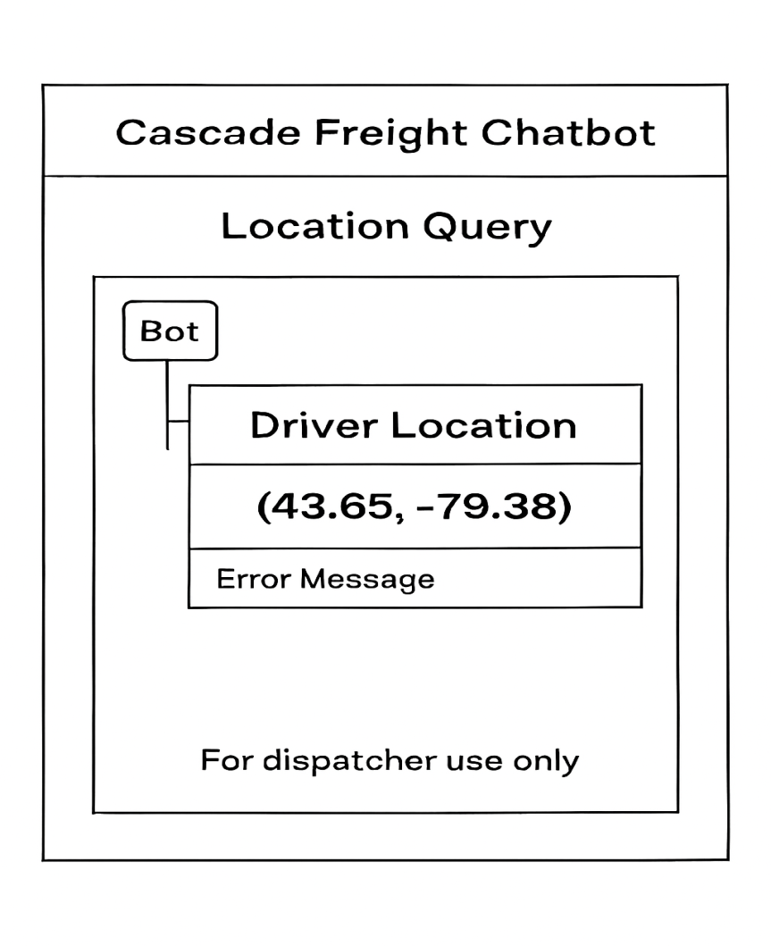
Cascade Freight Systems Chatbot
User Account Administration
User Story – 2.1.2 Location Query
As a dispatcher, I want to query a driver’s last known location from internal GPS/logs so that I can track their position and make informed decisions about assignments and shipment coordination.
Development Tasks
Database/Logs: Connect to GPS/location logs for driver data.
Backend: Build API to fetch and return driver location.
Frontend: Display location clearly (coordinates or map view).
Security: Enforce dispatcher‑only access; log queries.
Testing: Validate location accuracy and role‑based access..

Slide 5
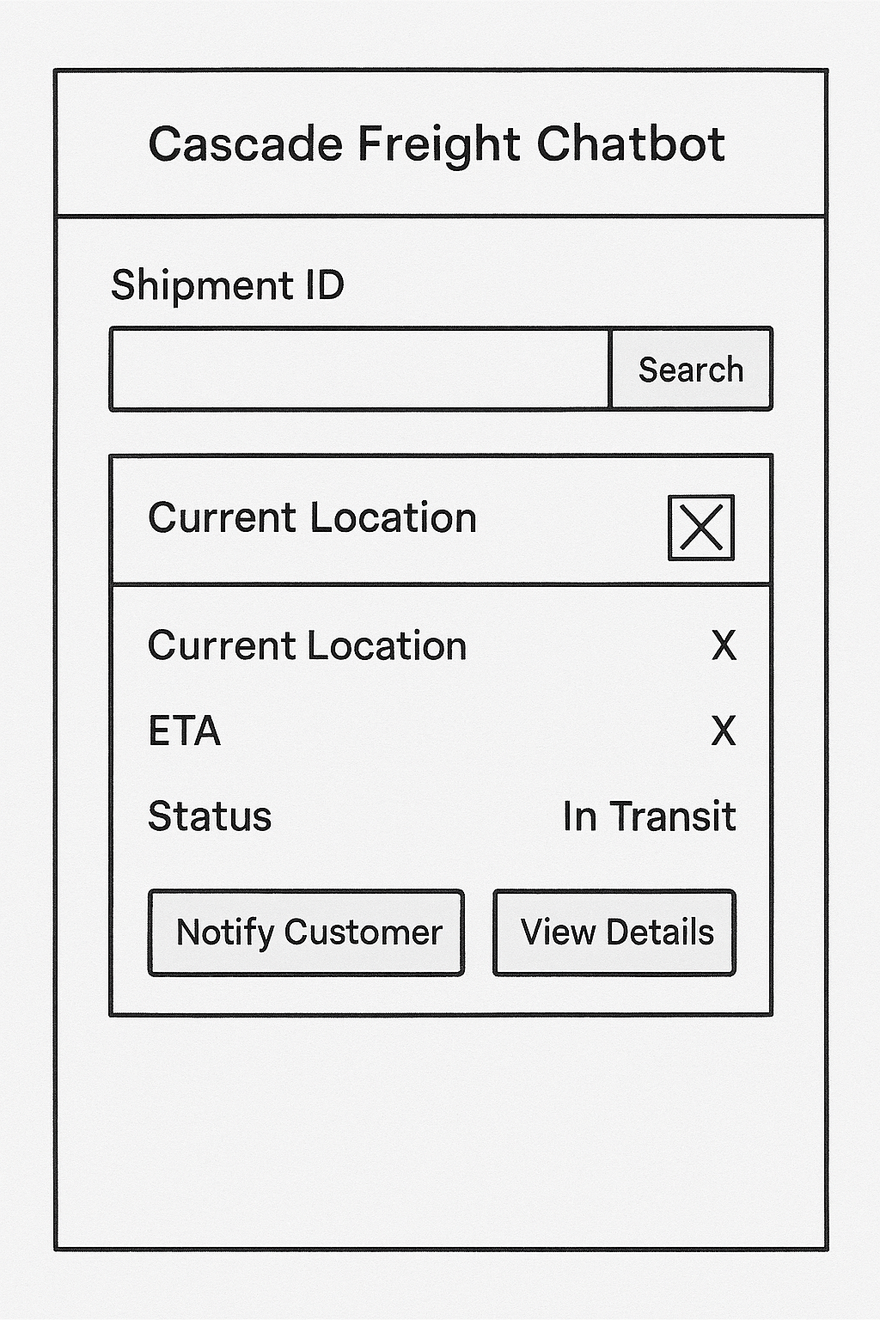
Cascade Freight Systems Chatbot
User Account Administration
User Story – 2.2 Shipment Status Query
As a dispatcher, I want to query a shipment’s current status so that I can provide accurate updates to customers.
Development Tasks
Build shipment status API endpoint.
Create dispatcher UI panel for shipment search.
Integrate real‑time shipment tracking feed.
Add error handling for missing shipment IDs.
Write unit and integration tests for status queries.

Slide 6
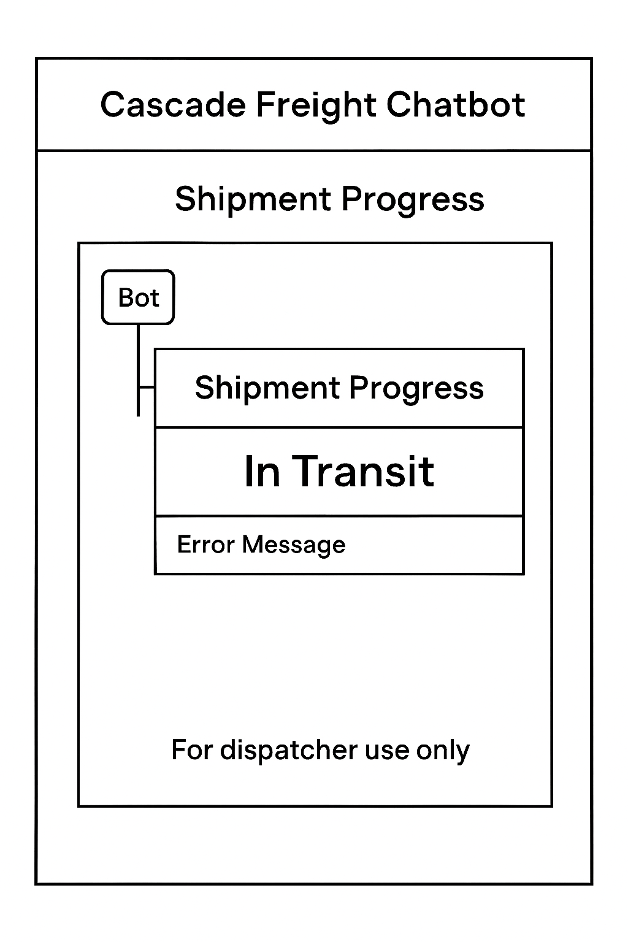
Cascade Freight Systems Chatbot
User Account Administration
User Story – 2.2.1 Real Time Updates
As a dispatcher, I want the chatbot to provide real‑time shipment progress from the internal database so that I can monitor shipments accurately and respond quickly to inquiries.
Development Tasks
Integrate chatbot with the internal shipment database API for live data retrieval.
Implement query handling to fetch and format shipment progress updates.
Add caching/refresh logic to ensure updates are current without overloading the system.
Build error handling for unavailable or delayed database responses.
Test real‑time update responses with sample shipment scenarios to validate accuracy.

Slide 7
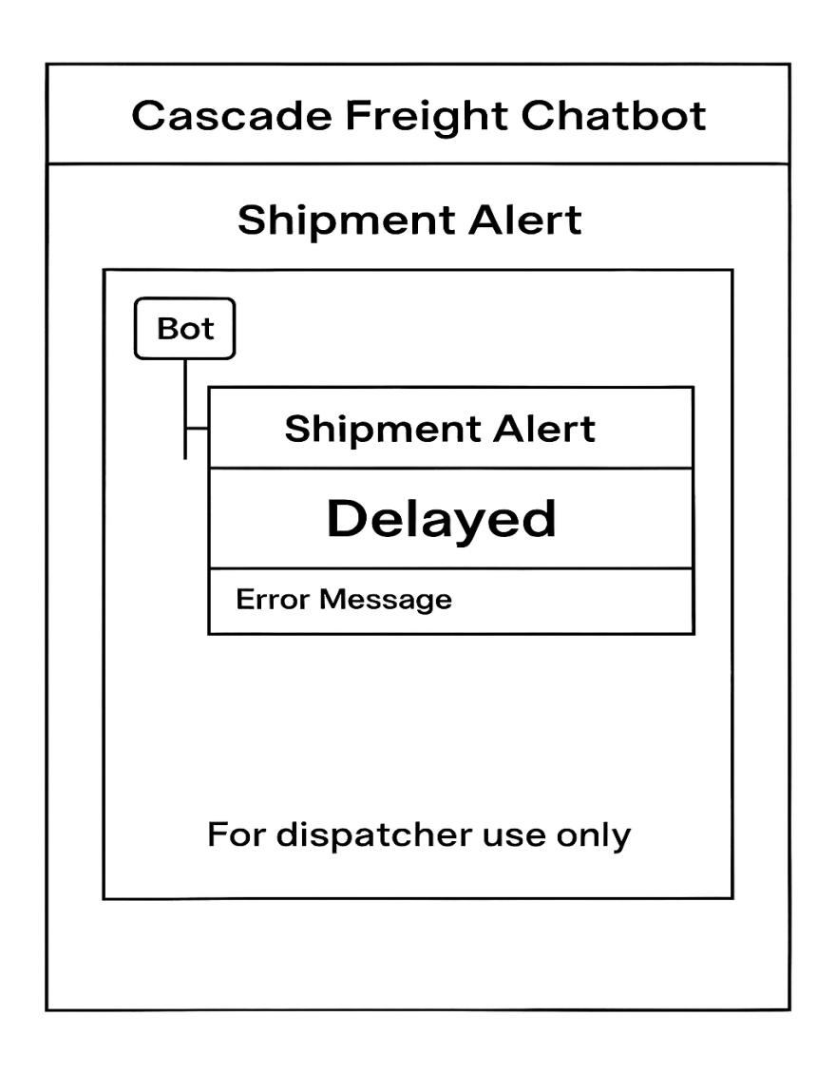
Cascade Freight Systems Chatbot
User Account Administration
User Story – 2.2.2 Exception Alerts
As a dispatcher, I want the chatbot to automatically flag shipment delays, reroutes, or issues so that I can respond quickly and keep operations on track.
Development Tasks
Connect chatbot to shipment monitoring system to detect exceptions in real time.
Implement alert logic to identify delays, reroutes, or flagged issues.
Format and deliver alerts clearly to dispatchers within the chatbot interface.
Add logging of all alerts for audit and review purposes.
Test alert triggers with simulated shipment exceptions to validate accuracy.

Slide 8
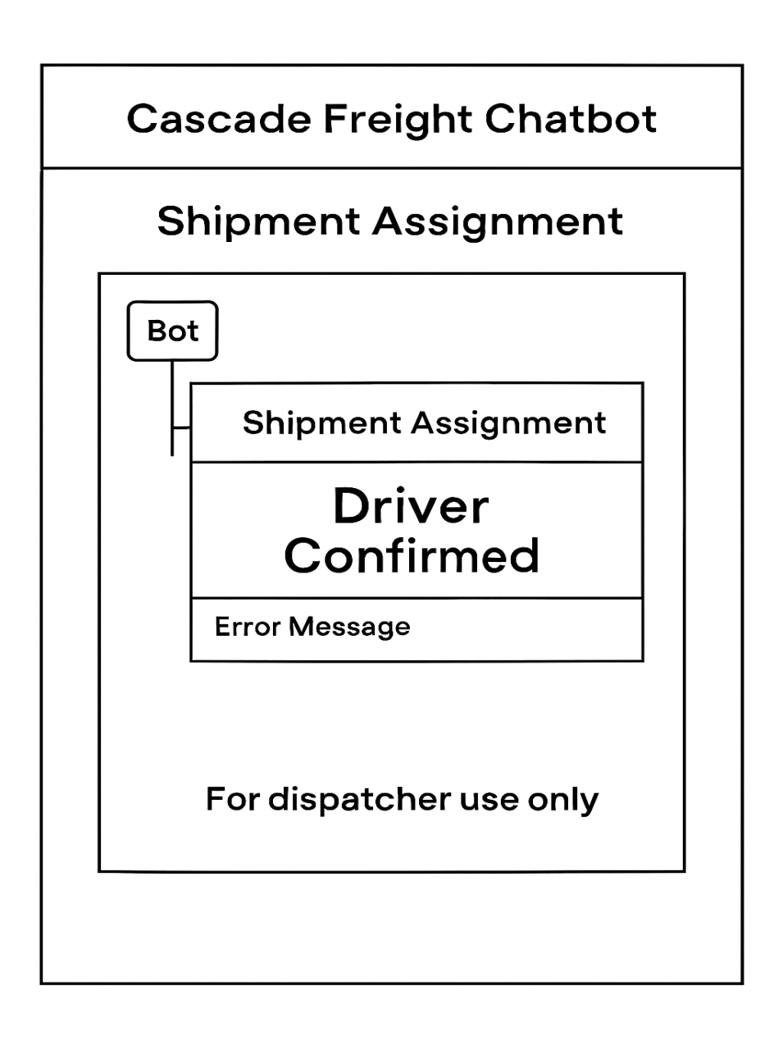
Cascade Freight Systems Chatbot
User Account Administration
User Story – 2.3 Assignment Management
As a dispatcher, I want the chatbot to let me confirm or update driver‑shipment assignments so that I can adapt quickly to changes in availability or routing..
Development Tasks
Build chatbot commands to confirm or update driver‑shipment assignments securely.
Integrate with internal assignment database to reflect changes in real time.
Implement validation checks to prevent unauthorized or conflicting updates.
Log all assignment changes for audit and compliance purposes.
Test assignment workflows with sample driver and shipment records to ensure reliability.

Slide 9
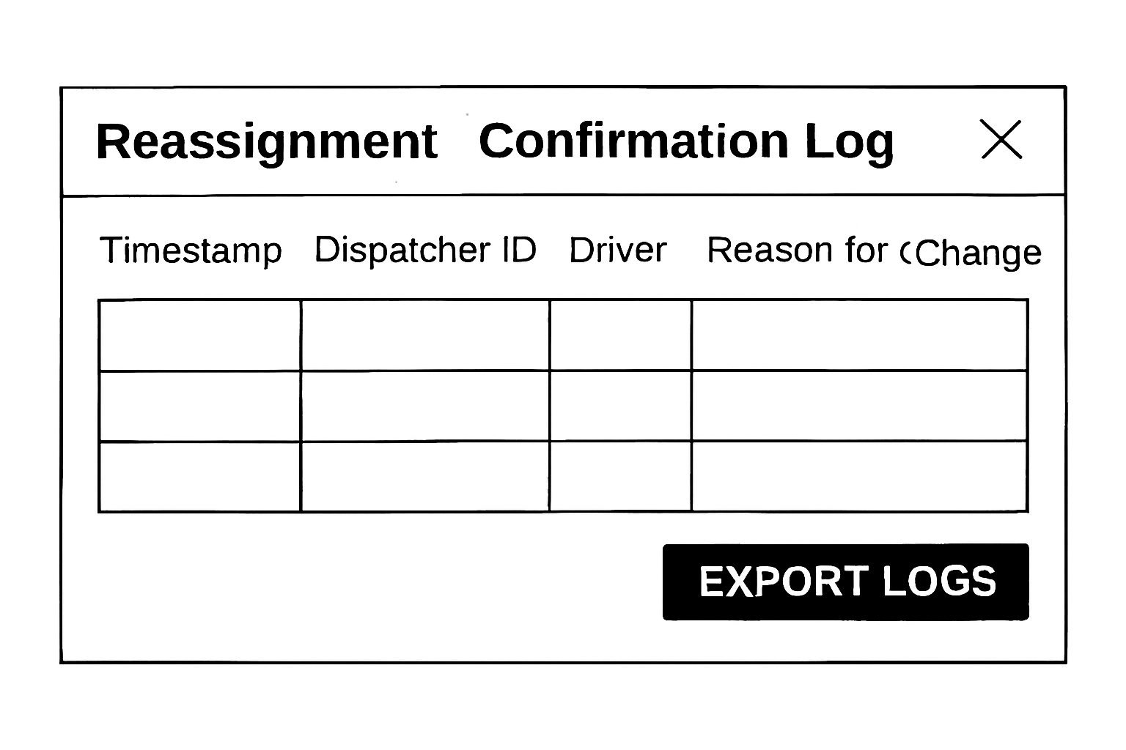
Cascade Freight Systems Chatbot
User Account Administration
User Story – 2.3.1 Reassignment Requests
As a dispatcher, I want the chatbot to let me securely reassign shipments to different drivers so that I can balance workloads and adapt to changes in driver availability.
Development Tasks
Implement chatbot commands for initiating and confirming shipment reassignments.
Integrate with driver assignment database to update records in real time.
Add security checks to ensure only authorized dispatchers can perform reassignments.
Log all reassignment actions for audit and compliance purposes.
Test reassignment workflows with sample driver and shipment records to validate functionality.

Slide 10
Cascade Freight Systems Chatbot
User Account Administration
User Story – 2.3.2 Confirmation Logging
As a dispatcher, I want the chatbot to record all assignment changes with confirmations so that I can maintain accurate audit trails and ensure accountability.
Development Tasks
Implement logging functionality to capture every assignment change with user ID, timestamp, and reason.
Store confirmation records securely in the internal audit database.
Ensure logs are immutable and accessible only to authorized roles.
Integrate confirmation logging with existing audit review tools.
Test logging accuracy by simulating assignment changes and verifying stored records.

